Slide 1
INVENTORY MANAGEMENT SYSTEM -VAISHNAVI S
MY INVENTORY MODULE MANAGES INVENTORY OF FRAMES,CONTACT LENSES AND OTHER OPTICAL MISCELLANEOUS.
INVENTORY MANAGEMENT
SALES BILLING
PURSCHASING
BILLINGS
ORDERS WITH DETAILS
WITH ALL HISTORY REPORTS AND PRESCRIPTION

Slide 2

OPTICARE - IMS
BETTER STOCK MANAGER

Slide 3
OPTICARE-IMS
HOME | ABOUT | CONTACT US
SHOP NAME
OWNER NAME
MOBILE
EMAIL
PASSWORD
RE-TYPE PASSWORD
REGISTER NOW
ALREADY HAVE AN ACCOUNT ? | LOGIN

Slide 4
OPTICARE-IMS
HOME | ABOUT | CONTACT US
 | LOGIN
USERID
PASSWORD
LOGIN | RESET | BACK
NEW REGISTRATION | FORGOT PASSWORD

Slide 5
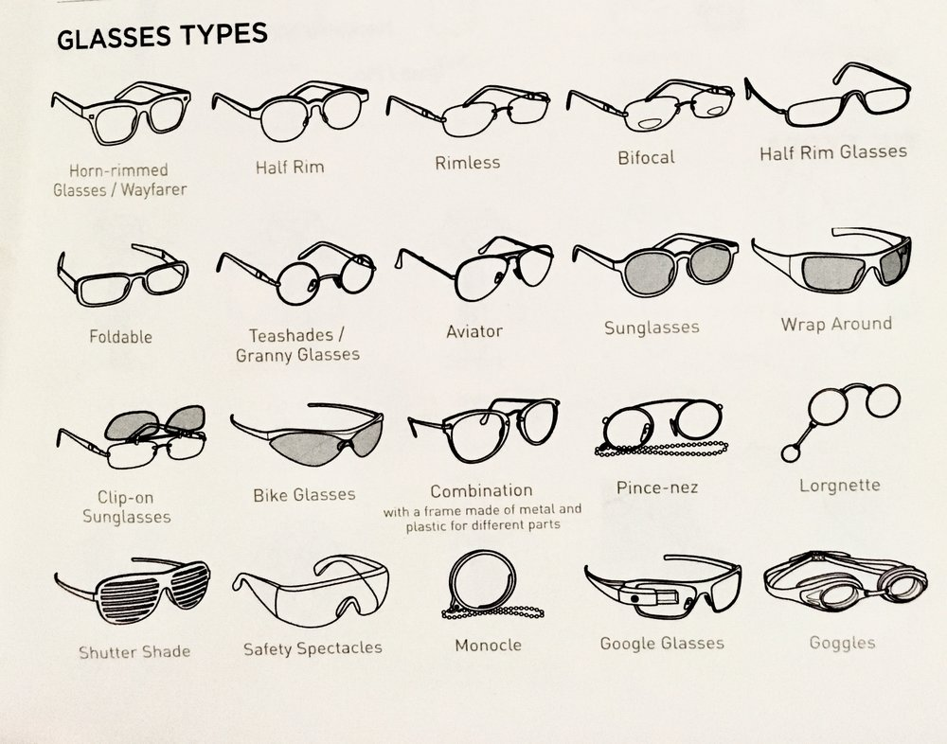
ABOUT
CONTENT....

Slide 6
CONTACT US
PHONENO.
EMAIL
OTHER SOCIAL MEDIA QUICK LINKS

Slide 7

OPTICARE-IMS
DASHBOARD
PRODUCT
SALES
PURSCHASE
STOCK –IN &OUT
BILLING
EXIT
NEW ORDER | CUSTOMER PROFILE
PRESCRIPTION DETAILS | ALERTS!!!!

Slide 8
NEW ORDER
ORDER DETAILS
ORDER DATE: | COMPLETE DATE:
CUSTOMER DETAILS
CUSTOMER PROFILE APPEARS HERE
PRESCRIPTION DETAILS
BILL DETAILS

Slide 9
CUSTOMER PROFILE
CUSTOMER ID: | PRESCRIPTION ID:
EYE DETAILS
CONTACT
AGE
ADDRESS
EYE | SPH | CYL | AXIS | VD | NEAR ADD | VN
RIGHT
LEFT
MODELNO. |  | BRAND
FRAME TYPE |  | LENS PRICE
LENS SIDE |  | FRAME PRICE
PAID AMOUNT |  | TOTAL AMOUNT
ADD | DELETE | UPDATE | EXIT

Slide 10
PRESCRIPTION DETAILS
CHANGE DATE
SEARCH
EYE CHECKUP BY:
DOCTOR /OPTICIAN:
PRESCRIPTION ID:
CONTACT:
SAVE | DELETE

Slide 11
ALERTS!!!!
EYEGLASSES | CHECK MODELNO.
CONTACT LENS | LENS NO. IS EXPIRING SOON
SOLUTIONS | ITEMNO. IS EXPIRING SOON

Slide 12
OPTICARE-IMS
DASHBOARD
PRODUCT
SALES
PURCHASE
STOCK
REPORT
EXIT
PRODUCT
CATEGORY
EYEGLASSES
CONTACT LENS
SOLUTIONS

Slide 13

eyeglasses
SEARCH GO | FILTERBY -----
MODELNO.
BRAND
FRAME TYPE
SIZE
PRICE
PRICE+GST=TOTAL
IMAGE
UNIT | + | --
ADD PRODUCT | DELETE
UPDATE | EXIT

Slide 14

CONTACT LENS
LENS NO.
BRAND
CHOOSE PACK | DAILY/WEEKLY/MONTHLY/YEARLY
EXPIRY DATE
COLOR
TOTAL PRICE(PER/PAIR)
ADD LENS | UPDATE
DELETE | EXIT

Slide 15
SOLUTIONS
ITEMNO.
BRAND
EXPIRY DATE
PRICE
ADD SOLUTIONS | UPDATE
DELETE | EXIT

Slide 16
SALES
SORT BY DATE | SORT BY MONTH
ORDER DEATILS WILL APPEAR HERE

Slide 17
PURCHASE
SORT BY DATE | SORT BY MONTH
PURCHASE ID
COMPANY NAME
PHONE
WEBSITE
EMAIL
ADD | DELETE
UPDATE | EXIT

Slide 18
STOCK
MODELNO./LENS NO. | BRAND | PRICE TYPE | SIZE | SALES PRICE | PURCHASE PRICE | UNIT | TOTAL STOCK AVAILABLE
SALES
PURCHASE
DEATILS

Slide 19
BILLING
BILL ID | CUSTOMER ID
BILLNO. | BILL DATE | BILL AMOUNT
ORDER DETAILS WILL APPEAR HERE

Slide 20
INVOICE
BILL RECEIPT | ADD | CANCEL
BILL TO: | INVOICE NO: DATE: DUE DATE:
# | BRAND | MODELNO. | UNIT | RATE | DISCOUNT | GST | TOTAL
1.
2.
 | TOTAL
AMOUNT(INWORDS)
DECLARATION: WE DECLARE THAT THIS INVOICE SHOWS THE ACTUAL PRICE OF GOODS DESCTIBED AND THAT ALL PARTICULARS ARE TRUE AND CORRECT
AUTHORISED SIGN/NO.

Slide 21
REPORT
CUSTOMER REPORT
SALES REPORT
PURCHASE REPORT
PRODUCT REPORT
EXAMPLE
CUSTOMER REPORT
SORT BY DATE | SORT BY MONTH
PRINT | EXIT

